Slide 1
Building Data Warehouse By Inmon
Chapter 3: The Data Warehouse and Design
Prepared By:Song Nguyen
Date: 05/09/2022

Slide 2
3.0 Introduction
There are two major components to building a data warehouse:
The design of the interface from operational systems.
The design of the data warehouse itself.

Slide 3
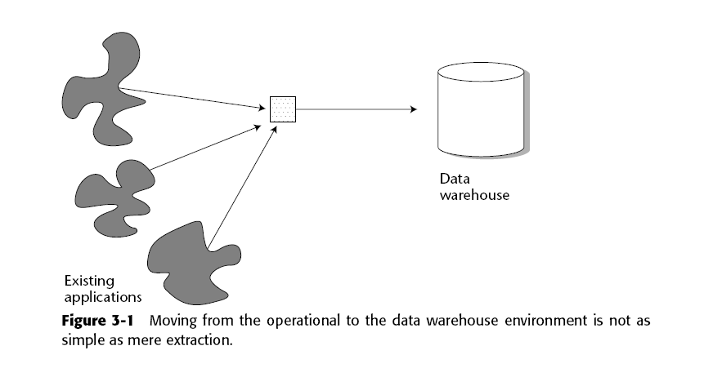
3.1 Beginning with Operational Data
Design begins with the considerations of placing data in the data warehouse.

Slide 4
3.1 Beginning with Operational Data (Different applications integration)

Slide 5
3.1 Beginning with Operational Data (Encoding Transformation)

Slide 6
3.1 Beginning with Operational Data ( Types of Data Load)
Three types of loads are made into the data warehouse from the operational environment:
Archival data
Data currently contained in the operational environment
Ongoing changes to the data warehouse environment from the changes (updates) that have occurred in the operational environment since the last refresh

Slide 7
3.1 Beginning with Operational Data (Data selection)

Slide 8
3.1 Beginning with Operational Data (Data Selection – time based)

Slide 9
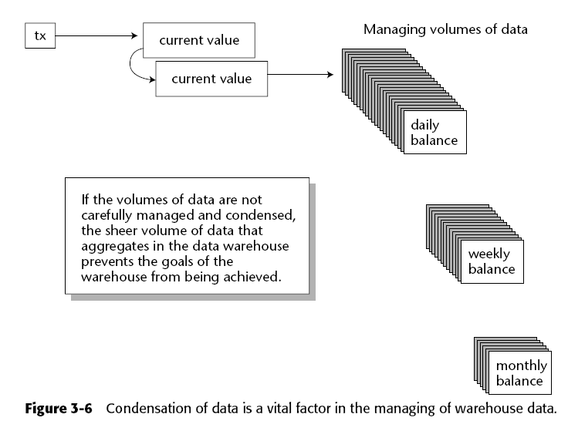
3.1 Beginning with Operational Data (Data Selection: spatial consideration)

Slide 10
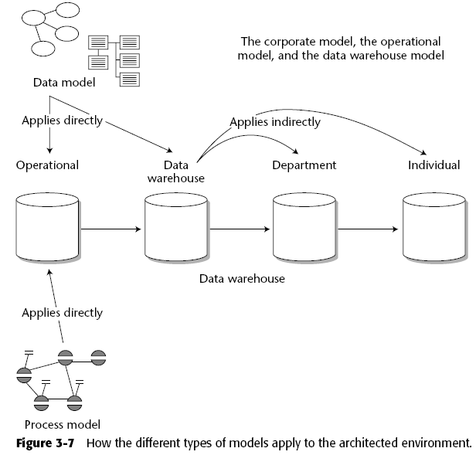
3.2 Process and Data Models and the Architected Environment

Slide 11
3.2 Process and Data Models and the Architected Environment (ct)
Data models are discussed in depth in the following section.
Functional decomposition
Context-level zero diagram
Data flow diagram
Structure chart
State transition diagram
HIPO chart
Pseudo code

Slide 12
3.3 The Data Warehouse and Data Models

Slide 13
3.3 The Data Warehouse and Data Models (ct)

Slide 14
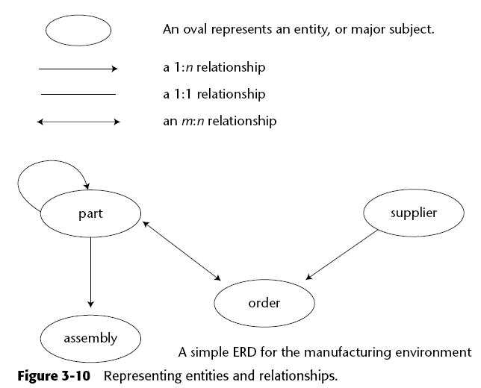
3.3.1 The Data Warehouse Data Model

Slide 15
3.3.1 The Data Warehouse Data Model (ct)

Slide 16
3.3.1 The Data Warehouse Data Model (ct)

Slide 17
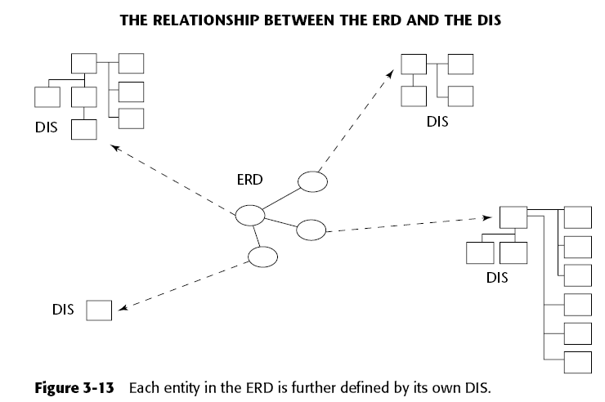
3.3.2 The Midlevel Data Model

Slide 18
3.3.2 The Midlevel Data Model (ct)
Four basic constructs are found at the midlevel model:
A primary grouping of data —The primary grouping exists once, and only once, for each major subject area. It holds attributes that exist only once for each major subject area. As with all groupings of data, the primary grouping contains attributes and keys for each major subject area.
A secondary grouping of data —The secondary grouping holds data attributes that can exist multiple times for each major subject area. This grouping is indicated by a line emanating downward from the primary grouping of data. There may be as many secondary groupings as there are distinct groups of data that can occur multiple times.
A connector—This signifies the relationships of data between major subject areas. The connector relates data from one grouping to another. A relationship identified at the ERD level results in an acknowledgment at the DIS level. The convention used to indicate a connector is an underlining of a foreign key.
“Type of” data —This data is indicated by a line leading to the right of a grouping of data. The grouping of data to the left is the supertype. The grouping of data to the right is the subtype of data.

Slide 19
3.3.2 The Midlevel Data Model (ct)

Slide 20
3.3.2 The Midlevel Data Model (ct)

Slide 21
3.3.2 The Midlevel Data Model (ct)

Slide 22
3.3.2 The Midlevel Data Model (ct)
Of particular interest is the case where a grouping of data has two “type of” lines emanating from it, as shown in Figure 3-17. The two lines leading to the right indicate that there are two “type of” criteria. One type of criteria is by activity type—either a deposit or a withdrawal. The other line indicates another activity type—either an ATM activity or a teller activity. Collectively, the two types of activity encompass the following transactions:
ATM deposit
ATM withdrawal
Teller deposit
Teller withdrawal

Slide 23
3.3.2 The Midlevel Data Model (ct)
The physical table entries that resulted came from the following two transactions:
An ATM withdrawal that occurred at 1:31 p.m. on January 2
A teller deposit that occurred at 3:15 p.m. on January 5

Slide 24
3.3.2 The Midlevel Data Model (ct)

Slide 25
3.3.3 The Physical Data Model

Slide 26
3.3.3 The Physical Data Model (ct)

Slide 27
3.3.3 The Physical Data Model (con’t)

Slide 28
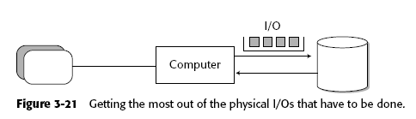
3.3.3 The Physical Data Model (con’t)

Slide 29
3.3.3 The Physical Data Model (con’t)
Note: This is not an issue of blindly transferring a large number of records from DASD to main storage. Instead, it is a more sophisticated issue of transferring a bulk of records that have a high probability of being accessed.

Slide 30
3.4 The Data Model and Iterative Development
Why iterative development is important ?
The industry track record of success strongly suggests it.
The end user is unable to articulate many requirements until the first iteration is done.
Management will not make a full commitment until at least a few actual results are tangible and obvious.
Visible results must be seen quickly.

Slide 31
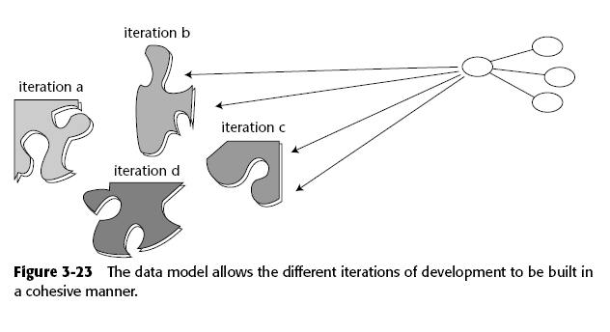
3.4 The Data Model and Iterative Development (ct)

Slide 32
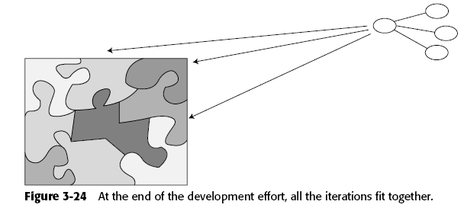
3.4 The Data Model and Iterative Development (ct)

Slide 33
3.5 Normalization and Denormalization (ERD: Entity Relationship Diagram)

Slide 34
3.5 Normalization and Denormalization (Dimensional Modeling Technique)

Slide 35
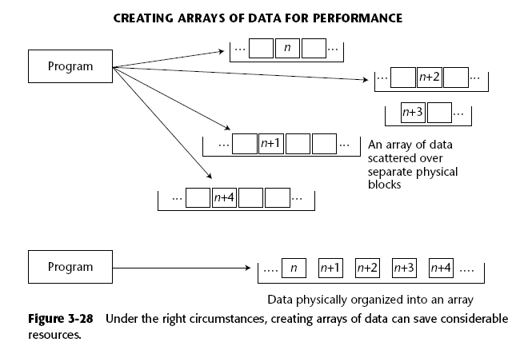
3.5 Normalization and Denormalization (hash algorithm: better search ability)

Slide 36
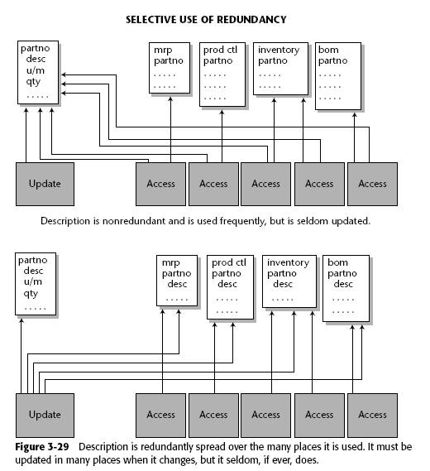
3.5 Normalization and Denormalization (Use of Redundancy data – search performance)

Slide 37
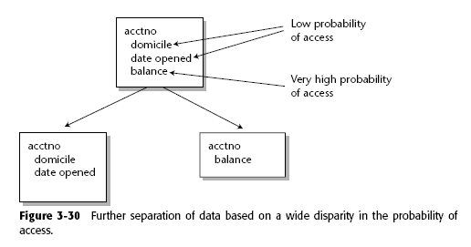
3.5 Normalization and Denormalization (Separation of data & access probability)

Slide 38
3.5 Normalization and Denormalization (Derived Data – What is it ?)

Slide 39
3.5 Normalization and Denormalization (Data Indexing vs. Profiles – Why ?)

Slide 40
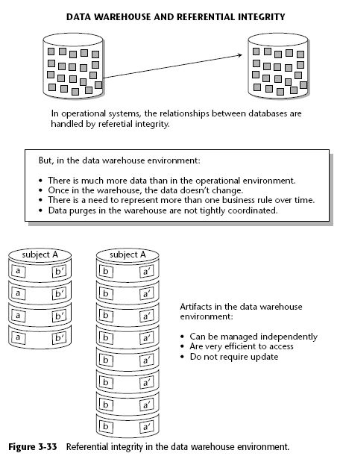
3.5 Normalization and Denormalization (Referential data Integrity)

Slide 41
3.5.1 Snapshots in the Data Warehouse
The snapshot triggered by an event has four basic components:
A key
A unit of time
Primary data that relates only to the key
Secondary data captured as part of the snapshot process that has no direct relationship to the primary data or key

Slide 42
3.5.1 Snapshots in the Data Warehouse (Primary Data)

Slide 43
3.5.1 Snapshots in the Data Warehouse (Primary & 2nd data)

Slide 44
3.6 Metadata
Metadata sits above the warehouse and keeps track of what is where in the warehouse such as:
Structure of data as known to the programmer
Structure of data as known to the DSS analyst
Source data feeding the data warehouse
Transformation of data as it passes into the data warehouse
Data model
Relationship between the data model and the data warehouse
History of extracts

Slide 45
3.6.1 Managing Reference Tables in a Data Warehouse

Slide 46
3.6.1 Managing Reference Tables in a Data Warehouse (ct)

Slide 47
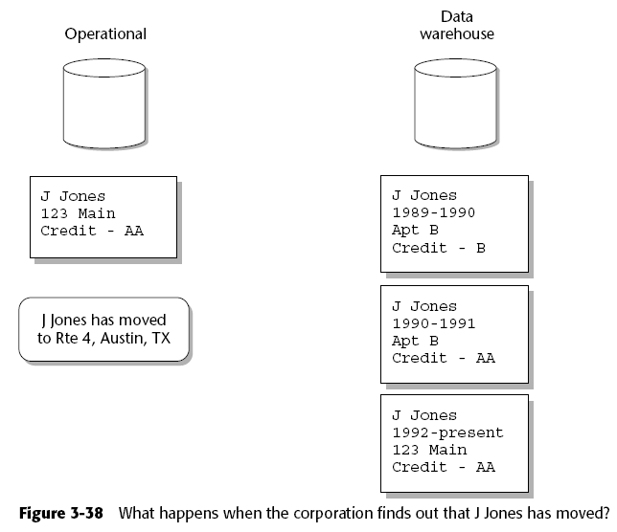
3.7 Cyclicity of Data—The Wrinkle of Time

Slide 48
3.7 Cyclicity of Data—The Wrinkle of Time (ct)

Slide 49
3.7 Cyclicity of Data—The Wrinkle of Time (ct)

Slide 50
3.8 Complexity of Transformation and Integration
As data passes from the operational, legacy environment to the data warehouse environment, requires transformations and or change in technologies
Extraction data from different sourcing systems
Transformation encoding rules and data types
Loading to new environment

Slide 51
3.8 Complexity of Transformation and Integration (ct)
The selection of data from the operational environment may be very complex.
Operational input keys usually must be restructured and converted before they are written out to the data warehouse.
Nonkey data is reformatted as it passes from the operational environment to the data warehouse environment.
As a simple example, input data about a date is read as YYYY/MM/DD and is written to the output file as DD/MM/YYYY. (Reformatting of operational data before it is ready to go into a data warehouse often becomes much more complex than this simple example.)

Slide 52
3.8 Complexity of Transformation and Integration (ct)
Data is cleansed as it passes from the operational environment to the data warehouse environment.
Multiple input sources of data exist and must be merged as they pass into the data warehouse.
When there are multiple input files, key resolution must be done before the files can be merged.
With multiple input files, the sequence of the files may not be the same or even compatible.
Multiple outputs may result. Data may be produced at different levels of summarization by the same data warehouse creation program.

Slide 53
3.8 Complexity of Transformation and Integration (ct)
Default values must be supplied.
The efficiency of selection of input data for extraction often becomes a real issue.
Summarization of data is often required.
Tracking the renaming of data elements as they are moved from the operational environment to the data warehouse.

Slide 54
3.8 Complexity of Transformation and Integration (ct)
The input record type conversion
Fixed-length records
Variable-length records
Occurs depending on
Occurs clause
Understand semantic (logical meanings) data relationship of old systems

Slide 55
3.8 Complexity of Transformation and Integration (ct)
Data format conversion must be done. EBCDIC to ASCII (or vice versa) must be spelled out.
Massive volumes of input must be accounted for.
The design of the data warehouse must conform to a corporate data model.

Slide 56
3.8 Complexity of Transformation and Integration (ct)
The data warehouse reflects the historical need for information, while the operational environment focuses on the immediate, current need for information.
The data warehouse addresses the informational needs of the corporation, while the operational environment addresses the up-to-the-second clerical needs of the corporation.
Transmission of the newly created output file that will go into the data warehouse must be accounted for.

Slide 57
3.9 Triggering the Data Warehouse Record
The basic business interaction that populated data warehouse is called an event-snapshot interaction.

Slide 58
3.9.2 Components of the Snapshot
The snapshot placed in the data warehouse normally contains several components.
The unit of time that marks the occurrence of the event.
The key that identifies the snapshot.
The primary (nonkey) data that relates to the key
Artifact of the relationship (secondary data that has been incidentally captured as of the moment of the taking of the snapshot and placed in the snapshot)

Slide 59
3.9.3 Some Examples
business activity might be found in a customer file.
The premium payments on an insurance policy.

Slide 60
3.10 Profile Records (sample)
The aggregation of operational data into a single data warehouse record may take many forms, including the following:
Values taken from operational data can be summarized.
Units of operational data can be tallied, where the total number of units is captured.
Units of data can be processed to find the highest, lowest, average, and so forth.
First and last occurrences of data can be trapped.
Data of certain types, falling within the boundaries of several parameters, can be measured.
Data that is effective as of some moment in time can be trapped.
The oldest and the youngest data can be trapped.

Slide 61
3.10 Profile Records (ct)

Slide 62
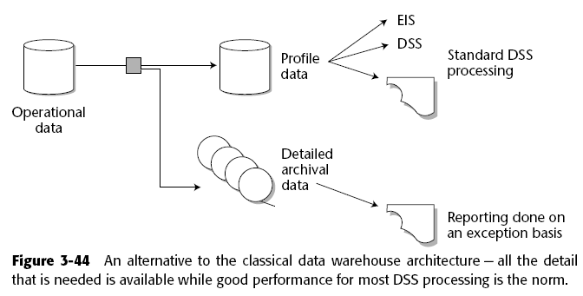
3.11 Managing Volume

Slide 63
3.12 Creating Multiple Profile Records
Individual call records can be used to create:
A customer profile record
A district traffic profile record
A line analysis profile record so forth.

Slide 64
3.13 Going from the Data Warehouse to the Operational Environment

Slide 65
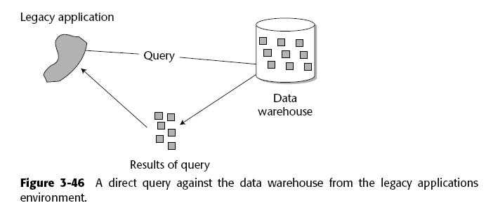
3.14 Direct Operational Access of Data Warehouse Data

Slide 66
3.14 Direct Operational Access of Data Warehouse Data (Issues)
Data Latency (data from one source may not be ready for loading)
Data Volume (sizing)
Different technologies (DMBS, flatfiles, etc)
Different format or encoding rules

Slide 67
3.15 Indirect Access of Data Warehouse Data (solution)
One of the most effective uses of the data warehouse is the indirect access of data warehouse data by the operational environment

Slide 68
3.15.1 An Airline Commission Calculation System (Operational example)
The customer requests a ticket and the travel agent wants to know
Is there a seat available?
What is the cost of the seat?
What is the commission paid to the travel agent?
The airline clerk must enter and complete several transactions:
Are there any seats available?
Is seating preference available?
What connecting flights are involved?
Can the connections be made?
What is the cost of the ticket?
What is the commission?

Slide 69
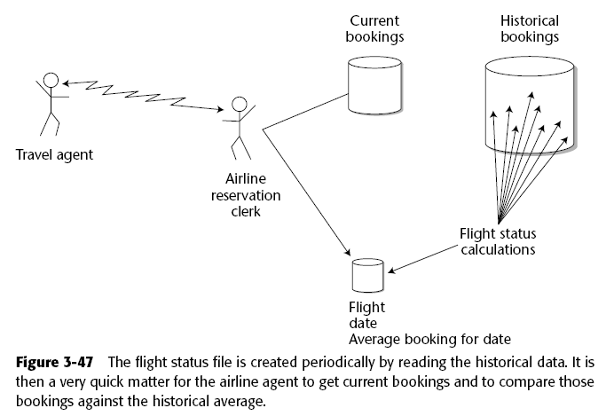
3.15.1 An Airline Commission Calculation System (ct)

Slide 70
3.15.2 A Retail Personalization System
The retail sales representative could find out some other information about cust.
The last type of purchase made
The market segment or segments in which the customer belongs
While engaging the customer in conversation, the sales representative may initiates
“I see it’s been since February that we last heard from you.”
“How was that blue sweater you purchased?”
“Did the problems you had with the pants get resolved?”

Slide 71
3.15.2 A Retail Personalization System (Demographics/Personalization data)
In addition, the retail sales clerk has market segment information available, such as the following:
Male/female
Professional/other
City/country
Children
Ages
Sex
Sports
Fishing
Hunting
Beach
Retail sales representative is able to ask pointed questions, such as these:
“Did you know we have an unannounced sale on swimsuits?”
“We just got in some Italian sunglasses that I think you might like.”
“The forecasters predict a cold winter for duck hunters. We have a special on waders right now.”

Slide 72
3.15.2 A Retail Personalization System (ct)

Slide 73
3.15.2 A Retail Personalization System (ct)
Periodically, the analysis program spins off a file to the operational environment that contains such information as the following:
Last purchase date
Last purchase type
Market analysis/segmenting

Slide 74
3.15.3 Credit Scoring based on (Demographics data)
The background check relies on the data warehouse. In truth, the check is an eclectic one, in which many aspects of the customer are investigated, such as the following:
Past payback history
Home/property ownership
Financial management
Net worth
Gross income
Gross expenses
Other intangibles

Slide 75
3.15.3 Credit Scoring (ct)
The analysis program is run periodically and produces a prequalified file for use in the operational environment. In addition to other data, the prequalified file includes the following:
Customer identification
Approved credit limit
Special approval limit

Slide 76
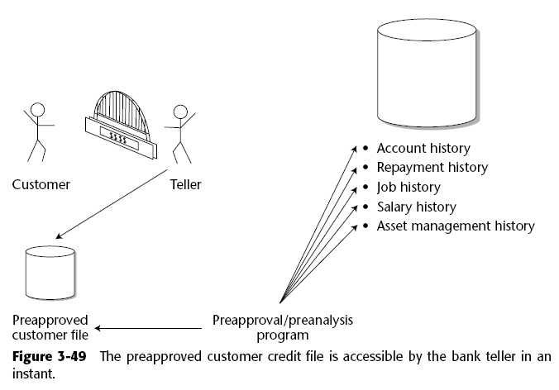
3.15.3 Credit Scoring (ct)

Slide 77
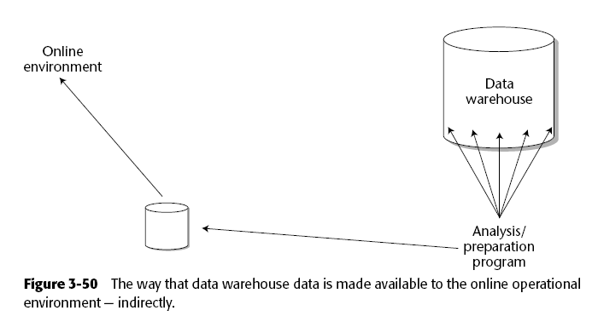
3.16 Indirect Use of Data Warehouse Data

Slide 78
3.16 Indirect Use of Data Warehouse Data (ct)
Following are a few considerations of the elements of the indirect use of data warehouse data:
The analysis program:
Has many characteristics of artificial intelligence
Has free rein to run on any data warehouse data that is available
Is run in the background, where processing time is not an issue (or at least not a large issue)
Is run in harmony with the rate at which data warehouse changes
The periodic refreshment:
Occurs infrequently
Operates in a replacement mode
Moves the data from the technology supporting the data warehouse to the technology supporting the operational environment

Slide 79
3.16 Indirect Use of Data Warehouse Data (ct)
The online pre-analyzed data file:
Contains only a small amount of data per unit of data
May contain collectively a large amount of data (because there may be many units of data)
Contains precisely what the online clerk needs
Is not updated, but is periodically refreshed on a wholesale basis
Is part of the online high-performance environment
Is efficient to access
Is geared for access of individual units of data, not massive sweeps of data

Slide 80
3.17 Star Joins
There are several very good reasons why normalization and a relational approach produces the optimal design for a data warehouse:
It produces flexibility.
It fits well with very granular data.
It is not optimized for any given set of processing requirements.
It fits very nicely with the data model.

Slide 81
3.17 Star Joins (ct)

Slide 82
3.17 Star Joins (ct)

Slide 83
3.17 Star Joins (ct)

Slide 84
3.17 Star Joins (ct)

Slide 85
3.17 Star Joins (ct)

Slide 86
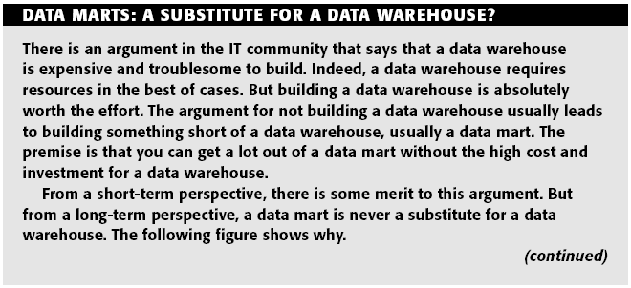
3.17 Star Joins (ct)

Slide 87
3.17 Star Joins (ct)

Slide 88
3.17 Star Joins (ct)

Slide 89
3.18 Supporting the ODS
In general, there are four classes of ODS:
Class I—In a class I ODS, updates of data from the operational environment to the ODS are synchronous.
Class II— In a class II ODS, the updates between the operational environment and the ODS occur within a two-to-three-hour time frame.
Class III—In a class III ODS, the synchronization of updates between the operational environment and the ODS occurs overnight.
Class IV—In a class IV ODS, updates into the ODS from the data warehouse are unscheduled. Figure 3-56 shows this support.

Slide 90
3.18 Supporting the ODS (ct)
The customer has been active for several years. The analysis of the transactions in the data warehouse is used to produce the following profile information about a single customer:
Customer name and ID
Customer volume—high/low
Customer profitability—high/low
Customer frequency of activity—very frequent/very infrequent
Customer likes/dislikes (fast cars, single malt scotch)

Slide 91
3.18 Supporting the ODS (ct)

Slide 92
3.19 Requirements and the Zachman Framework

Slide 93
3.19 Requirements and the Zachman Framework (ct)

Slide 94
Summary
Design of data warehouse
Corporate Data model
Operational data model
Iterative approach since requirements are a non-priori
Different SDLC approach
Data warehouse construction considerations
Data Volume (large size)
Data Latency (late arrival of data set)
Require transformation and understand of legacy
Data Models (granularities)
Low level
Mid Level
High Level
Structure of typical record in data warehouse
Time stamp, a surrogate key, direct data, secondary data

Slide 95
Summary (cont’)
Reference tables must be manage in time-variant manner
Data Latency – wrinkles of time
Data Transformation is complex
Different architectures
Different technologies
Different encoding rules and complex logics
Creation of data warehouse record is triggered by on event (activity)
A profile record is a composite representation of data (historical activities)
Star Join (is a preferred database design techniques

